Slide 1
Graph Algorithms
Dr. Tsung-Wei Huang
Department of Electrical and Computer Engineering
University of Utah, Salt Lake City, UT

Slide 2
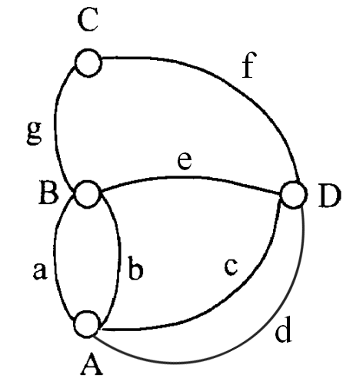
Definition of Graph
Vertex (V)
A, D, B, D
Edge (E)
BC, CD,…
degree (deg)
The branch of a vertex
Path (P)
A sequence of connected vertices, e.g. ADCB
Cycle (C)
A sequence of connected vertices with same end points
Notes:
A graph is a structure to a set of objects in which some pairs of the objects are in some sense related or connected. The object is called “vertex” and the connection is called “edge”.

Slide 3
Definition of Graph
Undirected Graph – G1, G2
Directed Graph – G3
Indegree and outdegree
1
1
1
2
3
2
3
2
4
4
5
6
7
3
G1
G2
G3

Slide 4
Definition of Graph
Multiple Edge
Complete Graph
1
4
2
3
G4
1
2
3
4
G1

Slide 5
Definition of Graph
Adjacent
for vertex
Incident
for edge
1
2
3
G3

Slide 6
Definition of Graph
Subgraph
1
1
1
2
3
1
2
3
2
3
2
3
G1
4
4
4
1
1
1
1
2
1
2
2
2
3
3
3
G3
Notes:
A subgraph is a graph whose vertex set is a subset of the vertex set …

Slide 7
Graph Data Structure
Adjacency list
std::vector<std::vector<int>>
1
v1
2
3
4
2
3
v2
1
3
4
4
v3
1
2
4
G1
v4
1
2
3

Slide 8
Graph Data Structure
Adjacency Matrix
1 2 3 4
1 0 1 1 1
2 1 0 1 1
3 1 1 0 1
4 1 1 1 0
1
2
3
4
G1

Slide 9
Graph Traversal
Depth First Search (DFS)
Stack
The algorithm starts at the root node (selecting some arbitrary node as the root node in the case of a graph) and explores as far as possible along each branch before backtracking.
Breadth First Search (BFS)
Queue
The algorithm starts at the root node, and explores all of the neighbor nodes at the present depth prior to moving on to the nodes at the next depth level.

Slide 10
DFS
V₁
1
2
3
V₁
V₂
2
1
4
5
V₃
3
1
6
7
V₂
V₃
V₄
4
2
8
0
V₅
5
2
8
0
V₄
V₅
V₆
V₇
V₆
6
3
9
0
V₈
V₉
V₇
7
3
9
0
V₈
8
4
5
10
V₁₀
V₉
9
6
7
10
V₁₀
10
8
9

Slide 11
DFS
Start from v1
V₁
V₂
V₃
V₄
V₅
V₆
V₇
V₃
V₈
V₉
V₁
V₂
V₁₀
output：V₁

Slide 12
DFS
Pop a node from the stack and insert its neighbors
V₁
V₂
V₃
V₄
V₄
V₅
V₆
V₇
V₂
V₅
V₈
V₉
V₃
V₃
V₁₀
output：V₁ V₂

Slide 13
DFS
Pop v4 from the stack and insert v8
V₁
V₂
V₃
V₄
V₈
V₄
V₅
V₆
V₇
V₅
V₅
V₈
V₉
V₃
V₃
V₁₀
output：V₁ V₂ V₄

Slide 14
DFS
Pop v10 from the stack and insert v9
V₁
V₂
V₃
V₈
V₁₀
V₄
V₅
V₆
V₇
V₅
V₅
V₈
V₉
V₃
V₃
V₁₀
output：V₁ V₂ V₄ V₈

Slide 15
DFS
Pop v8 from the stack and insert v10
V₁
V₂
V₃
V₁₀
V₉
V₄
V₅
V₆
V₇
V₅
V₅
V₈
V₉
V₃
V₃
V₁₀
output：V₁ V₂ V₄ V₈ V₁₀

Slide 16
DFS
Pop v10 from the stack and insert v9
V₁
V₂
V₃
V₇
V₉
V₆
V₄
V₅
V₆
V₇
V₅
V₅
V₈
V₉
V₃
V₃
V₁₀
output：V₁ V₂ V₄ V₈ V₁₀ V₉

Slide 17
DFS
Pop v7 from the stack and insert v3
V₁
V₂
V₃
V₇
V₃
V₆
V₆
V₄
V₅
V₆
V₇
V₅
V₅
V₈
V₉
V₃
V₃
V₁₀
output：V₁ V₂ V₄ V₈ V₁₀ V₉ V₇

Slide 18
DFS
Pop v3 from the stack
V₁
V₂
V₃
V₃
V₆
V₆
V₄
V₅
V₆
V₇
V₅
V₅
V₈
V₉
V₃
V₃
V₁₀
output：V₁ V₂ V₄ V₈ V₁₀ V₉ V₇ V₃

Slide 19
DFS
Pop v6 from the stack
V₁
V₂
V₃
V₆
V₄
V₅
V₆
V₇
V₅
V₅
V₈
V₉
V₃
V₃
V₁₀
output：V₁ V₂ V₄ V₈ V₁₀ V₉ V₇ V₃ V₆

Slide 20
DFS
Pop v5 from the stack
V₁
V₂
V₃
V₄
V₅
V₆
V₇
V₅
V₈
V₉
V₃
V₃
V₁₀
output：V₁ V₂ V₄ V₈ V₁₀ V₉ V₇ V₃ V₆ V₅

Slide 21
DFS
Pop v3 from the stack
No output for v3 as we did it before!
V₁
V₂
V₃
V₄
V₅
V₆
V₇
V₈
V₉
V₃
V₁₀
output：V₁ V₂ V₄ V₈ V₁₀ V₉ V₇ V₃ V₆ V₅

Slide 22
DFS Implementation in Stack
// Initially mark all vertices as not visited
vector<bool> visited(V, false);
// Create a stack for DFS
stack<int> stack;
// Push the current source node.
stack.push(s);
while (!stack.empty())
{
// Pop a vertex from stack and print it
s = stack.top();
stack.pop();
// Stack may contain same vertex twice. We print the popped item only if it is not visited.
if (!visited[s]) {
cout << s << " ";
visited[s] = true;
}
// Get all nonvisited adjacent vertices of the popped vertex s
for (auto i = adj[s].begin(); i != adj[s].end(); ++i)
if (!visited[*i]) stack.push(*i);
}

Slide 23
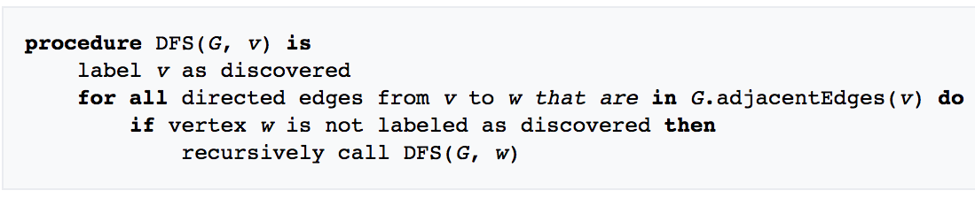
How can we write DFS recursively?

Slide 24
BFS
Start
Insert the starting node(s) to the queue
yes
empty？
no
Pop a node u from the queue
Insert all neighboring nodes of u to the queue
stop

Slide 25
BFS
2
4
8
s
5
7
3
6
9

Slide 26
BFS
1
2
2
4
8
Shortest path from s
0
s
5
7
3
6
9
Undiscovered
Discovered
Queue: s
Top of queue
Finished

Slide 27
BFS
1
2
4
8
0
s
5
7
3
3
6
9
1
Undiscovered
Discovered
Queue: s 2
Top of queue
Finished

Slide 28
BFS
1
2
4
8
0
s
5
5
7
1
3
6
9
1
Undiscovered
Discovered
Queue: s 2 3
Top of queue
Finished

Slide 29
BFS
1
2
4
8
0
s
5
7
1
3
6
9
1
Undiscovered
Discovered
Queue: 2 3 5
Top of queue
Finished

Slide 30
BFS
1
2
2
4
4
8
0
s
5
7
1
3
6
9
1
Undiscovered
Discovered
Queue: 2 3 5
Top of queue
Finished

Slide 31
BFS
1
2
2
4
8
5 already discovered: don't enqueue
0
s
5
7
1
3
6
9
1
Undiscovered
Discovered
Queue: 2 3 5 4
Top of queue
Finished

Slide 32
BFS
1
2
2
4
8
0
s
5
7
1
3
6
9
1
Undiscovered
Discovered
Queue: 2 3 5 4
Top of queue
Finished

Slide 33
BFS
1
2
2
4
8
0
s
5
7
1
3
6
9
1
Undiscovered
Discovered
Queue: 3 5 4
Top of queue
Finished

Slide 34
BFS
1
2
2
4
8
0
s
5
7
1
3
6
6
9
1
2
Undiscovered
Discovered
Queue: 3 5 4
Top of queue
Finished

Slide 35
BFS
1
2
2
4
8
0
s
5
7
1
3
6
9
1
2
Undiscovered
Discovered
Queue: 3 5 4 6
Top of queue
Finished

Slide 36
BFS
1
2
2
4
8
0
s
5
7
1
3
6
9
1
2
Undiscovered
Discovered
Queue: 5 4 6
Top of queue
Finished

Slide 37
BFS
1
2
2
4
8
0
s
5
7
1
3
6
9
1
2
Undiscovered
Discovered
Queue: 5 4 6
Top of queue
Finished

Slide 38
BFS
1
2
2
4
8
0
s
5
7
1
3
6
9
1
2
Undiscovered
Discovered
Queue: 4 6
Top of queue
Finished

Slide 39
BFS
1
2
3
2
4
8
8
0
s
5
7
1
3
6
9
1
2
Undiscovered
Discovered
Queue: 4 6
Top of queue
Finished

Slide 40
BFS
1
2
3
2
4
8
0
s
5
7
1
3
6
9
1
2
Undiscovered
Discovered
Queue: 4 6 8
Top of queue
Finished

Slide 41
BFS
1
2
3
2
4
8
0
s
5
7
7
1
3
3
6
9
1
2
Undiscovered
Discovered
Queue: 6 8
Top of queue
Finished

Slide 42
BFS
1
2
3
2
4
8
0
s
5
7
1
3
3
6
9
9
1
2
3
Undiscovered
Discovered
Queue: 6 8 7
Top of queue
Finished

Slide 43
BFS
1
2
3
2
4
8
0
s
5
7
1
3
3
6
9
1
2
3
Undiscovered
Discovered
Queue: 6 8 7 9
Top of queue
Finished

Slide 44
BFS
1
2
3
2
4
8
0
s
5
7
1
3
3
6
9
1
2
3
Undiscovered
Discovered
Queue: 8 7 9
Top of queue
Finished

Slide 45
BFS
1
2
3
2
4
8
0
s
5
7
1
3
3
6
9
1
2
3
Undiscovered
Discovered
Queue: 7 9
Top of queue
Finished

Slide 46
BFS
1
2
3
2
4
8
0
s
5
7
1
3
3
6
9
1
2
3
Undiscovered
Discovered
Queue: 7 9
Top of queue
Finished

Slide 47
BFS
1
2
3
2
4
8
0
s
5
7
1
3
3
6
9
1
2
3
Undiscovered
Discovered
Queue: 7 9
Top of queue
Finished

Slide 48
BFS
1
2
3
2
4
8
0
s
5
7
1
3
3
6
9
1
2
3
Undiscovered
Discovered
Queue: 7 9
Top of queue
Finished

Slide 49
BFS
1
2
3
2
4
8
0
s
5
7
1
3
3
6
9
1
2
3
Undiscovered
Discovered
Queue: 9
Top of queue
Finished

Slide 50
BFS
1
2
3
2
4
8
0
s
5
7
1
3
3
6
9
1
2
3
Undiscovered
Discovered
Queue: 9
Top of queue
Finished

Slide 51
BFS
1
2
3
2
4
8
0
s
5
7
1
3
3
6
9
1
2
3
Undiscovered
Discovered
Queue: 9
Top of queue
Finished

Slide 52
BFS
1
2
3
2
4
8
0
s
5
7
1
3
3
6
9
1
2
3
Undiscovered
Discovered
Queue:
Top of queue
Finished

Slide 53
BFS
1
2
3
2
4
8
0
s
5
7
1
3
3
6
9
1
2
3
Level Graph

Slide 54
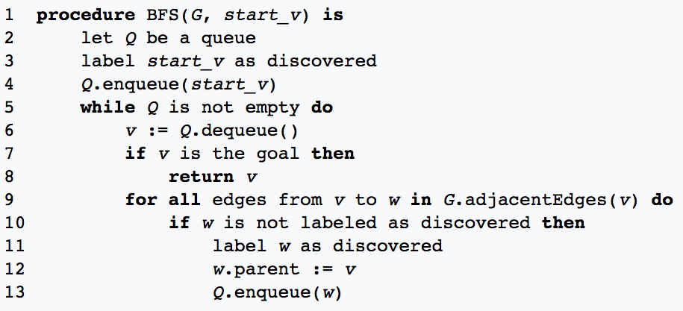
BFS Implementation

Slide 55
Computer Design Automation Flow
Physical synthesis (placement, routing, etc)

Slide 56
The Problem
Thousands of macro blocks
Millions of gates
Millions of wires
Kilometers of wire.
Notes:
We have figured out how to place all the gates that are created by the logic synthesis and then the technology mapping. And we have the new problem how to connect the wires and this is the routing problem. And in our big ASIC, you could have thousands of macro blocks representing you know, memories and other predefined chunks of things like processors and such. Millions and millions of gates, and millions of wires literally. A big ASIC, an industrial-size big ASIC could be 20 million wires or 40 millions wires. You're going to end up with, literally, kilometers of wire on the surface of the chip. It is physically impossible to do any of that stuff manually. We need tools, we need software to do this.

Slide 57
Basic Routing Problems
Scale
Big chips have an enormous number (millions) of wires
Not every wire gets to take an “easy” path to connect its pins
Must connect them all--can’t afford to tweak many wires manually
Geometric complexity
It used to be that the representation of the layout was a simple “grid”
No longer true: at nanoscale, geometry rules are complex – makes routing hard
Electrical complexity
It’s not enough to make sure you connect all the wires
You also must ensure that the delays thru the wires are not too big
And that wire-to-wire interactions (crosstalk) don’t mess up behavior
Notes:
One of the first problems we have to think about: The first is scale. Big chips have an enormous number. Millions of wires, and not every wire gets to take an easy path to, connect its pins. (explain …)
We have a lot of geometric complexity now too. At the nanoscale, wires that are some number of tens of nanometers across, the geometry rules are incredibly complex just to make the physics work. And that really makes the routing problem hard. Nevertheless we're going to do what everybody does when we start talking about routing, we're going to use a simple grid representation of the layout. It turns out that's the right place to start, and in fact the way real routers. The work is they, they have a sequence of tools. So just like placement, we got rid of some detail. We, for example, pretended the wires were two point springs, we pretended the gates had no physical size. And then we dealt with the, the massive scale part of the problem and then we circled back later and we did some other work to, to deal with the physical problems like the gates overlapping. When people build real routers we do the same thing. We make geometric abstractions like everything's on a grid. We deal with most of the problems with the simple geometry. And then we go in very close and we deal with, the, the detailed problems
(explain the final part)

Slide 58
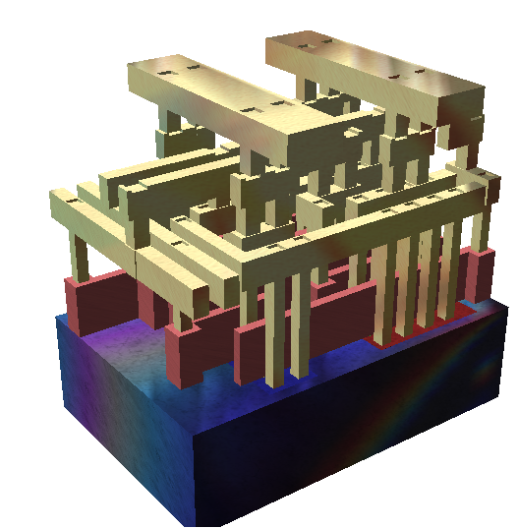
Physical Assumption
Many layers of wiring are available for routing
Made of metal (today, copper)
We can connect wires in different layers with vias
A simplified view
Standard cells are using metal on layers 1,2
Routing wires on layers 3-8
Upper layers (9, 10) reserved for power and clock distribution
Notes:
So, the first physical assumption to, to be aware of is that there's many layers of wiring available for routing at any real asic. So they are made of metal today, they're, copper and can connect wires across different layers with things called vais. This is kind of little plugs of metal that go from one layer of metal wiring to another layer of metal wiring.
Here is a really simple view. This is a standard cell, kind of NAND gate drawn in a 3D representation. Standard cells would typically be using metal on layers 1 and 2 to sort of connect things on the inside. The routing of the wires that would be connecting the logic gates would be up on, you know, 3, 4, 5, 6, 7, 8, maybe even 9 and 10, depending on the particular technology. (draw some metal layers)
The upper most layers of the wiring are often reserved for special things like the clocks, global signals, power distribution, things like that. (explain)

Slide 59
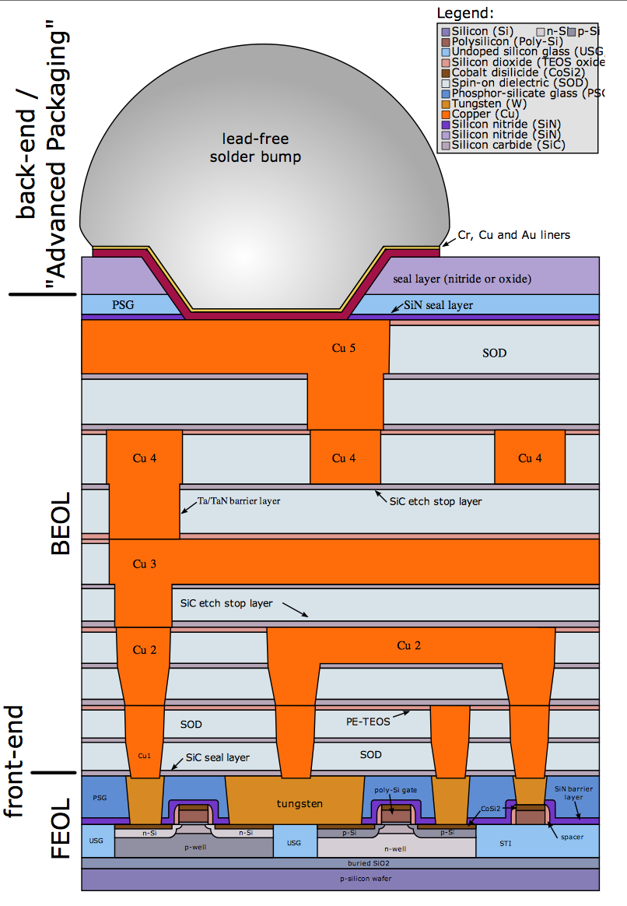
Typical Example (5 Layers, Circa 2000)
Some terminology
FEOL: Front end of line. Chip fabrication steps that make transistors on Si wafer
BEOL: Back end of line. Fabrication steps that make layers of wires on top of transistors
This picture
Cross sectional view of FEOL and BEOL structures in 5-layers of wiring…
… along with packaging connection (“bump”) which is how chip connects to pins on package
Notes:
Here is a typical example from about 2000, just something from Wikipedia and I am allowed to show it. This is a cross section view of a five layers of routing. Little bit of terminology if you look closely at the picture. FEOL, that’s what it says over here. That’s front end of line. And the line means the fabrication line, the manufacturing line. The front end stuff are the chip fabrication steps that make the transistors on the silicon wafer. Now that's as opposed to this label over here, the back end of the line.
Those are the fabrication steps that make the wires. And what you can see is that in terms of the vertical space, it's mostly back end of line. Because all of these wires are, you know, separate layers. This particular picture's cross sectional view of both the front end and back end of line stuff for five layers of wiring will always have stuff happening up at the top which is actually some packaging stuff.

Slide 60
Typical Example (5 Layers, Circa 2000)
Package
interconnect,
(like a via), but
from chip to board
Layer 5 metal
Thicker layers
(less resistance)
for clock, power
Layer 4 metal
Vias, connect Metal layers
k and k+1
Layer 3 metal
Layer 2 metal
Wiring for logic
Layer 1 metal
Transistors to make gate-level logic
Notes:
Here is the same picture again but with more labels. So again, the stuff at the bottom, those are the transistors. That's how we make the switches that actually make up the insides of our gate level logic. And then what we have, the orange things, are levels of metals. And so there's a layer 1 metal down at the bottom and then on top of that a layer 2 metal, and then on top of that a level 3 metal. And if you look very closely it will say something like CU1, CU2, CU3. CU means copper. So this is copper layer 1 metaling, copper layer 2 metaling, copper layer 3 metaling, and so on so forth. This is the wiring for the logic, this is how you connect stuff to make the logic.
On top of that there are yet more layers of metal, metal 4 and metal 5. And if you look very careful with this, one of the things you'll see is that the metal layers at the top are a little wider and they're a little thicker. And there's a reason for that. This is a designed part of all modern ASIC technologies. They're designed to be a little wider and a little thicker so they offer less electrical resistance. And the reason is for that is because you're going to be doing some special stuff up there. Like routing the clock that connects all the flip flops. And routing the power distribution and so you really care about things like resistance being low. And the way you do that is by making things thicker and wider, up at the top. So as you move upper, the wires become thicker and wider to offer less resistance.
And, up at the top, we've actually got a little piece of something interesting, this is package level interconnect. Because the wires on the chip need to connect to electrical connections off the chip, and they are at a much larger physical scale. And so, what that thing is up at the top is a solder bump. And that's just literary a big blob of metal.
Which is the appropriate electrical connection to a pin on a printed circuit board somewhere so you can take this chip, put it in the appropriate package.

Slide 61
Placement vs Routing
There are lots of different placement algorithms
Iterative methods. Used mainly for high-level floorplanning, not gate layout
Many analytical methods based on solving/optimizing large systems of equations
Quadratic wirelength, exponential model, etc.
There are not quite so many routing algorithms
There are lots of routing data structures – to represent the geometry efficiently
But there is one very, very big idea at core of most real routers…
Notes:
Now, a little bit placement versus routing. (explain…)

Slide 62

Big Idea “Maze Routing”
From one famous early paper:
E.F. Moore. “The shortest path through a maze”
International Symposium on the Theory of Switching Proceedings, pp 285--292, Cambridge, MA, Apr. 1959. Harvard University Press
Yes – it’s that Moore of “Moore finite state machines” fame
Given a maze (or a graph), find a shortest path from entrance to exit
Notes:
And so this is the big idea called maze routing, from one amazing early paper from EF Moore, The Shortest Path Through a Maze. This is the earliest work that talks about the routing problem in VLSI system design. And as an aside, yes, it’s the Moore. The Moore of Moore state machines. He did seminal work on computability theory and built reliable circuits using less reliable relays. A really famous guy.
And it's a very famous method, and depending on what computer science courses you've taken in the past, you might have actually built something that finds a path through a maze, through this very simple idea. And it's the basis for just tons of useful stuff in the chip design space.

Slide 63
How to Get from “Mazes” to “Wires”
Make a big geometric assumption: Gridded routing
The layout surface is a grid of regular squares
A legal wire path = a set of connected grid cells, through unobstructed cells in grid
For us: wires are also
strictly horizontal and vertical.
No diagonal (eg, 45º) angles.
A path goes east/west, or north/south, in this grid.
T
obstacle
N
S
W
E
S
Notes:
Let’s talk about how we get from a maze to a wrie. We are going to make a big geometric assumption which is called Gridded routing (explain the two items).
On the grid we can mark obstacles, things that obstruct, which we also call blockages, which are places we're not allowed to route. More or less simply put, we mark these cells in black in the grid where we're not allowed to route, and everything else in the grid is a place we are allowed to route. For example, there is an obstacle. Just a big black box that blocks things. And, here is a wire. The wire starts at a cell labeled with an s and it goes to a cell labeled with a t. And it goes Left and right, and then up and then to the right and up.
So for us, wires are strictly horizontal and vertical. There are no diagonals or funny angles, no 45 degrees. And it's often the case that we'll describe paths by compass Directions. And so this is just a set of compass directions, north on the top, south on the bottom, west on the left, east on the right. This is quite common in the router business.

Slide 64
Grid Assumption
A critical assumption – implies many constraints on wires
All wires are the same size (width)
All pins we want to connect are also “on grid” ie, center of grid cell
Wires and their vias fit in the grid, without any geometry rule (eg, spacing) violations
Via
Layer K
Layer
K+1
Notes:
The grid assumption is a pretty critical assumption. It applies a surprising amount of constraints on the wires. So it applies that all the wires are roughly the same size in terms of their width. Or more precisely that the wires and their vias which connect from one layer to another all fit in the grid. Without any rule violation. So the spacing rules are appropriately met.
For example, I can put you know, this wire on the left in this pair of grid cells vertically and this wire on the right in this pair of grid cells vertically. And so there's just this little grid, four cells across. I've got two blue wires going up the middle two columns. And, and then there are vias at the top of the middle two columns. And that apparently connects to a red layer, which looks like it's below, that goes to the left and the right. So let's say layer K plus one is the blue layer. Layer K is the red layer. I can define the grid width and height under a given spacing rules so any wires on the grid will all just work.
So it implies a lot of pieces of low level geometry kinds of assumptions and it's often an approximation of reality. but as it turns out it's a good approximation of reality, because you know when you've got 20 million wires and you've got to simplify some stuff to be able to make some progress. So we simplify some things. We solve most of the problem with a little bit of geometric simplification. We'll cycle back later. It's a good engineering approach to many things. It works.

Slide 65
Maze Routers History
1959 – Basic Idea
E.F. Moore. The shortest path through a maze. In International Symposium on the Theory of Switching Proceedings, Apr. 1959. Harvard University Press
1961 – Applied to electronics (board wiring)
Lee, C. Y., “An algorithm for path connections and its applications”, IRE Trans. on Electronic Computers, pp. 346-365, Sept. 1961
Chester Lee of Bell Labs invents the algorithm; gets famous for “Lee routers”
1974
Rubin, F., “The Lee path connection algorithm”, IEEE Trans. on Computers, vol. c-23, no. 9, pp. 907-914, Sept. 1974.
Frank Rubin applies some ideas from recent AI results to make it go much faster (some interesting ideas in the AI can be applied to this and vice versa)
1983
Hightower, D., “The Lee router revisited”, ICCAD, pp. 136-139, 1983.
Dave Hightower uses fact that “modern” computers have big virtual memory, builds great router
ACM ISPD 2007-2008 Global Routing Contests
ACM ISPD 2018-2019 Initial Detailed Routing Contest
… a lot of works still going on
Notes:
So let’s take a look at the history of most basic kind of maze router. (explain …)

Slide 66
Maze Routing Strategy
Strategy
One net at a time: completely wire one net, then move onto next net
Optimize net path: find the best wiring path
Problems
Early nets wired may block path of later nets
Optimal choice for one net may block later nets
We are just going to ignore this one for the moment…
Notes:
So, the maze routing strategy at a high level is that we're going to route one net at a time. We're going to completely route the one net, and then we're going to move onto the next net. And we're going to optimize the path of the net. we're going to find the best wiring path for each one. We would like the path to be as short as possible.
And there are some problems. Early nets that are wired may block the path of later nets that's actually easy to see in the little example. You know, the optimal choice for any one net may not be good for a later net. (draw an example)

Slide 67
Maze Router: Basic Idea for 2-Pin Nets
Given:
Grid - each square cell represents where one wire can cross
A source and target
Problem:
Find shortest path connecting source cell (S) and target cell (T)
When using cells, a wire can:
S
T
cross or bend
Notes:
So the basic maze router, the basic idea is you're going to give me a grid, and each square cell represents where one wire can cross. And we're going to start by connecting two points, and the points are historically and traditionally called the source and the target. You start from the source, and you route to the target. And the problem is to find a shortest path connecting the source cell and the target cell. And, so when using the cells, a wire can, for example it can cross the cell, so you
can cross vertically. You can also cross horizontally, or you can bend, you can go into the cell and you can sort of turn and go out sideways. So you can do anything you want in a cell. As you can just assume that all the geometry is correctly set up so that any wire can cross any cell.

Slide 68
Maze Routing: Expansion
S
Start at the source
Find all new cells that are reachable
at pathlength 1, ie, all paths that are just 1 unit in
total length (just 1 cell) - mark all with this the pathlength
1
2
Using the pathlength 1 cells,
find all new cells which
are reachable at pathlength 2
2
1
2
2
Repeat until the
target is found.
Notes:
Now the big core idea of a maze router is you start with a source cell, just the single cell, and then you find all new cells that … (explain … cell immediately adjacent to the cells)
The big idea in Maze routing is you just continue this process. That's the big great idea. At each expansion, or people call it wavefront, you know, like something got spread from the inside to the outside, you basically get one more unit of length from the previous one. And you just keep going until one of those cells labels the target with a path cost, a pathlength and you found a path.

Slide 69
Maze Router Step 1: Expand
Strategy
Expand one cell at a time until all the shortest paths from S to T are found.
Expansion creates a wavefront of paths that search broadly out from source cell until target is hit
S
T
Notes:
Let’s do one example. We start with the source cell. We say, what are all the paths of length one? And the answer is, it's that one.

Slide 70
Maze Router Step 1: Expand
Strategy
Expand one cell at a time until all the shortest paths from S to T are found.
Expansion creates a wavefront of paths that search broadly out from source cell until target is hit
1
S
T
Notes:
Okay, what are all the paths that have length two? And the answer is, it is this diamond of cells north, south, east and west of the source one cell (draw). These cells are all paths with length 2.

Slide 71
Maze Router Step 1: Expand
2
Strategy
Expand one cell at a time until all the shortest paths from S to T are found.
Expansion creates a wavefront of paths that search broadly out from source cell until target is hit
2
1
2
S
2
T
Notes:
(go outside and see the cell immediately adjacent to the previous cells)

Slide 72
Maze Router Step 1: Expand
3
2
3
Strategy
Expand one cell at a time until all the shortest paths from S to T are found.
Expansion creates a wavefront of paths that search broadly out from source cell until target is hit
2
1
2
3
S
3
2
3
3
T

Slide 73
Maze Router Step 1: Expand
3
2
3
4
Strategy
Expand one cell at a time until all the shortest paths from S to T are found.
Expansion creates a wavefront of paths that search broadly out from source cell until target is hit
2
1
2
3
4
S
3
2
3
4
4
3
4
4
T

Slide 74
Maze Router Step 1: Expand
3
2
3
4
5
Strategy
Expand one cell at a time until all the shortest paths from S to T are found.
Expansion creates a wavefront of paths that search broadly out from source cell until target is hit
2
1
2
3
4
5
S
3
2
3
4
5
4
3
4
5
5
4
5
T
5

Slide 75
Maze Router Step 1: Expand
3
2
3
4
5
6
Strategy
Expand one cell at a time until all the shortest paths from S to T are found.
Expansion creates a wavefront of paths that search broadly out from source cell until target is hit
2
1
2
3
4
5
S
3
2
3
4
5
6
4
3
4
5
6
5
4
5
6
T
6
5
6

Slide 76
Maze Router Step 1: Expand
3
2
3
4
5
6
Strategy
Expand one cell at a time until all the shortest paths from S to T are found.
Expansion creates a wavefront of paths that search broadly out from source cell until target is hit
2
1
2
3
4
5
S
3
2
3
4
5
6
4
3
4
5
6
7
5
4
5
6
7
T
6
5
6
7
Notes:
Where the paths there are seven units away oh, look they are also one unit away from sixes. Oh, look I have hit the target. I have labeled the target with a number, and the number I have labeled the target with is a seven. What does that mean? There's a path of length seven from the source to the target.
Each of these expansion steps, you know going from the threes to the fours, going from the fours to the fives, going from the fives to the sixes, creates a wave front of paths. And the analogy is if you drop a rock in a pond, the waves, you know, go out in a circle. Well in this case the waves go out (draw example) kind of in a diamond shape.

Slide 77
Maze Router Step 2: Backtrace
3
2
3
4
5
6
Now what? Backtrace
Select a shortest-path (any shortest-path) from target back to source
Mark its cells so they cannot be used again – mark them as obstacles for later wires we want to route
Since there are many paths back, optimization information can be used to select the best one
Here, just follow the pathlengths in the cells in descending order
2
S
1
2
3
4
5
3
2
3
4
5
6
4
3
4
5
6
7
5
4
5
6
T
7
6
5
6
7
Notes:
Now what do we do? We have found a cost of the path but we need to restore the path otherwise it doesn’t make sense. So we need to backtrace the path from the gird with all these labels. We need to select a shortest-path, you might have already noticed that there are multiple shortest paths in this case, you just pick up any shortest path from the target back to source. (explain …)

Slide 78
Maze Router Step 3: Clean-up
Now what? Clean-up
Clean up the grid for the next net, leaving the S to T path as an obstacle
Now, ready to route the next net with the obstacles from the previously routed net in place in the grid
S
T
Notes:
Then what you do, you do a step called clean-up. Clean-up is just what it sounds, clean-up says, get rid of all the stuff you put in the grid, so that the grid is in a state ready to route the next wire. So if you just put some path length numbers in the grid, you go erase them all. And let's also just make sure that you relabel the path you just found as an obstacle because the next wire can not use any of those cells. So you clean up the grid for the next net, leaving the S to T path you just found for this net as an obstacle.
Now you are ready to route the next net with the obstacles from the previously routed net in place in the grid, with previous net represented as obstacles.

Slide 79
Maze Router: Obstacles
Also called “Blockages”
Any cell you cannot use for a wire is a an obstacle or a blockage
There may be parts of the routing surface you just cannot use
But most importantly, you label each newly routed net as a blockage
Thus, all future nets must route around this blockage
S
S
T
T
Notes:
Now the obstacles are, are, we sometimes call them obstacles. We sometimes call them blockages. Any cell you cannot use for a wire is an obstacle. An obstacle or a blockage. (explain the four items)
So I am showing you this example. I got a new net S and T. You are going to find the path from S to T using the maze routing procedure. So you start with S labeled with 1, and go one step (…) If I backtrace the wire, what I am going to have here is …

Slide 80
Classical Maze Router
Summarizing three main steps:
Expand
Breadth-first-search to find all paths from source to target
Backtrace
Walk shortest path back to the source and mark path cells as used
Clean-Up
Erase all distance marks from other grid cells before next net is route.
Notes:
Summarizing these three steps of maze routing. Expand a breadth first search to find all the paths from the source to target in path length order. Why do we call it a breadth first search? You find all the paths of length three before you find the paths of length four. You find all the paths of length four before you find all the paths of length five, and so on. Every path you found the length is always larger than the previous one and that’s exactly how this labeling process works.
Backtrace, walk a shortest path back to the source. And then mark the path cells as obstacles so that you can keep routing.
And then clean-up erases all the other stuff you put in the grid, returning it to its original clean state, so that you can route the next net with the previous nets represented as obstacles. So that's the basic idea.

Slide 81
Some Algorithmic Concerns
Storage
Do we need a really big grid to represent a big routing problem?
What information is required in each cell of this grid?
Complexity
Do we really have to search the whole grid each time we add a wire?
Technology
Just 1 wiring layer? How do we do 2 layers? 3? 4? 6? 8? 10?
How do we deal with vias (connecting different routing layers?)
2 issues here
Applications of basic algorithm versus implementation issues
Notes:
(explain …)

Slide 82
How do we Deal Multi-point Nets
Multi-point Nets
One source → Many targets
You get this with any net that represents fanout (ie, almost all real nets)
Simple strategy
Start: Pick one point as source, label all the others as targets
First: Use maze route algorithm to find path from source to nearest target
Note: You don’t know which one this is up front, routing will find it
Next: Re-label all cells on found path as sources, then rerun maze router using all sources simultaneously
Repeat: For each remaining unconnected target point

Slide 83
Multi-point Nets
Given:
A source and many targets
Problem:
Find a short path connecting source and targets
S
T
T

Slide 84
Multi-point Nets
First segment of path...
Run maze route to find the closest target
Start at source, go till we find any target
3
2
3
4
5
2
S
1
2
3
4
5
3
2
3
4
5
T
4
3
4
5
5
4
5
T
5

Slide 85
Multi-point Nets
Second...
Backtrace and re-label the whole route as Sources for the next pass
Note – this is different
We don’t relabel the path as blockage (yet), as we did before
We label it as source, so we can find paths from any point on this segment, to the rest of the targets
3
2
3
4
5
2
S
1
2
3
4
5
3
2
3
4
5
T
4
3
4
5
5
4
5
T
5

Slide 86
Multi-point Nets
Second...
We will expand this entire set of source cells to find next segment of the net
Idea is we will look for paths of length 1 away from this whole set of sources, then length 2, 3, etc.
Go till hit another target
S
S
T
S
S
S

Slide 87
Multi-point Nets
3
4
5
Trick
Expand from all these sources to find the shortest path from the existing route to the next target
Next: Backtrace as before
Follow pathlengths in decreasing order from target, to some source cell
2
3
2
S
1
2
3
4
5
2
S
1
2
3
4
T
5
2
S
1
2
3
4
5
2
S
1
S
1
2
3
4
3
2
2
3
4
5

Slide 88
Multipoint Nets
Finally
Do usual cleanup
Mark all of the segment cells as used and clean-up the grid
Now, have embedded a multipoint net, and rendered it an obstacle for future nets
S
S
1
2
3
4
T
5
S
S
S

Slide 89
Is this Strategy Optimal?
Does this method give us guaranteed shortest multi-point net?
No!
Maybe surprising, but this is just a good heuristic
The optimal path has a name: called a Steiner Tree
How hard is to get the optimal Steiner Tree?
NP-hard! (ie, exponentially hard)
Yet another example of why CAD is full of tough, important problems to solve

Slide 90
Steiner Tree Construction
2 so-called “Steiner-points”
EASY
HARD!
Pins to connect
Route it so we guarantee each 2-point path
is shortest; this is Minimum Spanning Tree
Redraw it--different
orientations
of 2-point paths
Now we can see the
better (shorter)
Steiner tree

Slide 91
Real Routers …
Are often iterative
Problem: How do you know where the wire wants to go? You don’t know till you know where the other wires want to go?
Solution: So, route all the wires, leave some info on the routing surface, or even previous wires, about congestion, overlaps, etc. Then iteratively ripup (remove) and reroute the wires, using cost info from geometric footprint of previous wires.
Are always hierarchical
Problem: measured in terms of metal pitch, big chip has an intractable number of locations to search for each wire
In 2008, the M1 pitch was about 120nm. A simple gridded router for 1cm x 1cm chip = 83K x 83K cells = ~7 billion grid cells (ugh)
This is waaaay too many places to look for each path…

Slide 92
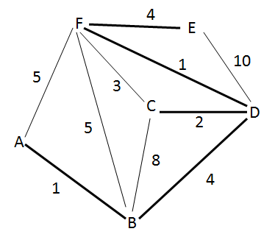
Minimum Spanning Tree
A fast alternative to Steiner tree routing
Not optimal, but quite good in practice
Input: graph G with weights on the edges
Output: connected sub graph G’ of G that includes all the vertices of G, of minimum total weight

Slide 93
Exhaustive Search
List all connected sub-graphs of G
Return sub-graph with least weight
Number of vertices, N, and number of edges, M
O(m^{n-1})

Slide 94
Greedy Algorithm
Start with a graph containing just the vertices, G’={V,Ø}
Add edges with the least weight until the graph is connected but no cycles are created
To do this:
Order the edges in increasing weight
While the graph is not connected, add an edge
End when all vertices are connected

Slide 95
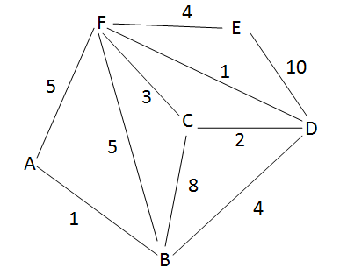
Greedy Algorithm - Example
Initial Graph:
List of Edges:
Edge | Weight
AB | 1
AF | 5
BC | 8
BD | 4
BF | 5
CD | 2
CF | 3
DE | 10
DF | 1
EF | 4

Slide 96
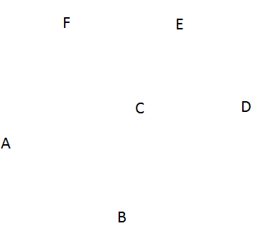
Greedy Algorithm - Example
Start with G’={V,Ø} and sorted list of edges
Graph:
Sorted List of Edges:
Edge | Weight
AB | 1
DF | 1
CD | 2
CF | 3
BD | 4
EF | 4
AF | 5
BF | 5
BC | 8
DE | 10

Slide 97
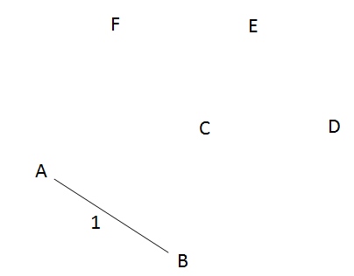
Greedy Algorithm - Example
Add edge from list to graph s.t. no cycles are created
Remove edge from list
Graph:
Sorted List of Edges:
Edge | Weight
AB | 1
DF | 1
CD | 2
CF | 3
BD | 4
EF | 4
AF | 5
BF | 5
BC | 8
DE | 10

Slide 98
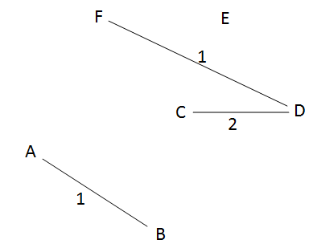
Greedy Algorithm - Example
Add edge from list to graph s.t. no cycles are created
Remove edge from list
Graph:
Sorted List of Edges:
Edge | Weight
AB | 1
DF | 1
CD | 2
CF | 3
BD | 4
EF | 4
AF | 5
BF | 5
BC | 8
DE | 10

Slide 99
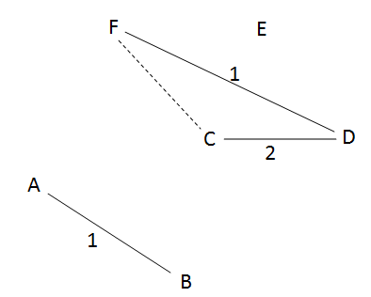
Greedy Algorithm - Example
Graph:
Sorted List of Edges:
Edge | Weight
CF | 3
BD | 4
EF | 4
AF | 5
BF | 5
BC | 8
DE | 10
Check for cycles using Depth First Search starting at a vertex in the added edge:
Start at C
C-> D -> F -> C
C gets visited twice => a cycle exists and CF should not be added to the graph

Slide 100
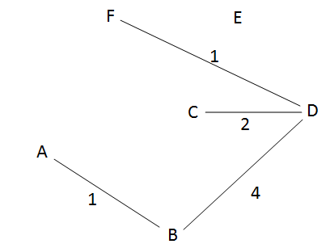
Greedy Algorithm - Example
Add edge from list to graph s.t. no cycles are created
Remove edge from list
End when all vertices can be visited (graph is connected)
Graph:
Sorted List of Edges:
Edge | Weight
BD | 4
EF | 4
AF | 5
BF | 5
BC | 8
DE | 10
Check for cycles using Depth First Search starting at a vertex in the added edge:
Start at B
B ->D ->C -> F -> A
If all vertices are visited by DFS, then the graph is connected and we are done

Slide 101
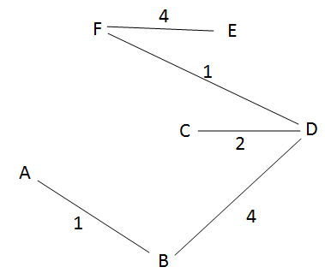
Greedy Algorithm - Example
Add edge from list to graph s.t. no cycles are created
Remove edge from list
End when all vertices can be visited (graph is connected)
Graph:
Sorted List of Edges:
Edge | Weight
EF | 4
AF | 5
BF | 5
BC | 8
DE | 10
Check for cycles using Depth First Search starting at a vertex in the added edge:
Start at E
E -> F -> D -> B -> A ->C
All vertices were visited and there were no cycles => we have found a minimum spanning tree with weight 12.

Slide 102
Greedy Algorithm- Psuedocode
Given G = (V, E)
G’ <- (V,Ø)
While G’ is not connected
Add e Є E to G’ s.t. G’ is acyclic and e is minimum
Remove e from E

Slide 103
Summary
Graph algorithms
DFS
BFS
Routing application in circuit designs
Minimum spanning tree
Final starts on 12/8 and ends at 23:59 PM 12/12
Cover everything in the class

